Slide 1

ROBOTIC HEAD CONNECTED TO CHAT GPT
BY: BEEMA DEWAN T.D. (3108821106016)
DEECHANA J (310821106017)
INDHUMATHI V (310821106031)
SUPERVISOR NAME: MRS. GRACELLIN SHEEBA, M.E

Slide 2
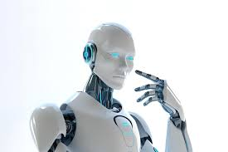
OBJECTIVE
This project presents the design and implementation of an animatronic robotic head that combines basic facial expressions with real time AI based conversational capabilities.
Mimicking human like interaction by integrating jaw and eye movements.
Built using 3D-printed plastic for lightweight, customizable facial features, and is controlled by an Arduino microcontroller.
This fusion of mechanical expression and conversational AI provides a new direction for enhancing human-robot interaction in fields such as education, customer service, and therapy.

Slide 3
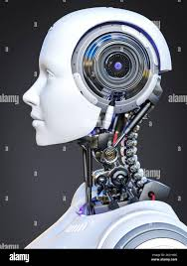
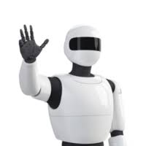
ABSTRACT
Project Overview: Developed an animatronic robotic head capable of real-time AI-powered conversations and human-like facial expressions using ChatGPT to enhance human-robot interaction.
Natural Interaction: Combined natural language processing with expressive facial movements to achieve emotionally intelligent and lifelike communication.
Hardware Design: Used multiple servo motors for simulating facial gestures such as eye and jaw movement, driven by an Arduino-based setup.
Speech Integration: Employed a microphone with STT (speech-to-text) for capturing user input, ChatGPT for generating context-aware replies, and TTS (text-to-speech) for verbal output.
System Implementation: Integrated cost-effective hardware (Arduino, servos) and AI
APIs, ensuring a scalable and accessible solution.

Slide 4
LITERATURE SURVEY
S. No. | Author & Year | Title / System | Technology Used | Contribution | Limitations
1 | MIT Media Lab (2000) | Kismet – Emotionally Expressive Robot | Embedded systems, motor control, basic AI. | Emotional response using facial movements | No deep conversation capabilities
2 | Hanson Robotics (2016) | Sophia – A Humanoid Robot | Facial motors, NLP, AI | Realistic facial expressions; responds to questions | High cost, proprietary, limited accessibility
3 | Furhat Robotics (2020) | Furhat Social Robot | 3D projection, conversational AI | Real-time facial projection and conversation | Projection-based, not mechanical facial movement

Slide 5
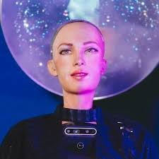
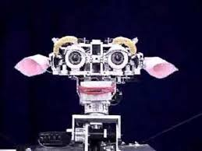
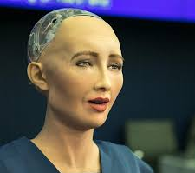
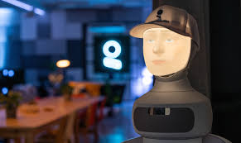
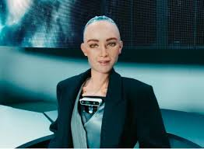
LITERATURE SURVEY
Kismet (2000) – Emotionally expressive robot using motor control and basic AI; lacks conversational depth.
Sophia (2016) – Humanoid robot with realistic facial expressions and AI-driven conversations; limited by high cost and proprietary design.
Furhat (2020) – Social robot with 3D facial projection and conversational AI; limited mechanical realism.
Insight – Progression from emotional mimicry to advanced AI interaction, each system balancing realism, accessibility, and expressiveness.

Slide 6
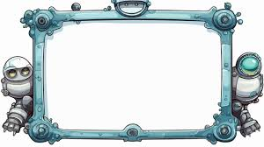
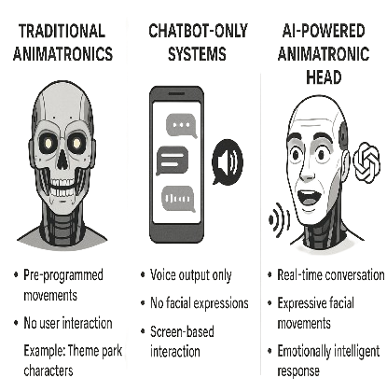
EXISTING MODEL
TRADITIONAL ANIMATRONICS:
Pre-programmed movement with no intelligent interaction.
Limited emotional connection or adaptation to user's mood.
Example: Theme park animatronics with recorded audio and fixed motions.
CHAT-BOT ONLY SYSTEMS:
Chatbots with voice output but no physical movements or expressions.
Lack of non-verbal cues reduces user immersion and emotional impact.
Dependency on screen-based interface rather than real-world interactivity.

Slide 7
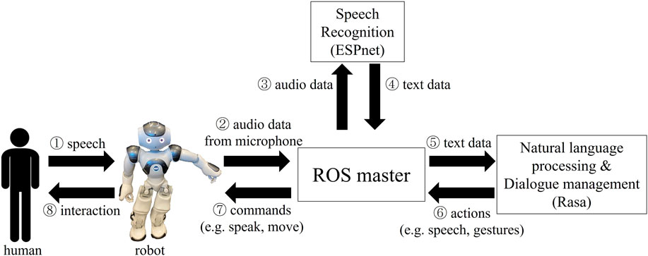
SYSTEM ARCHITECTURE

Slide 8
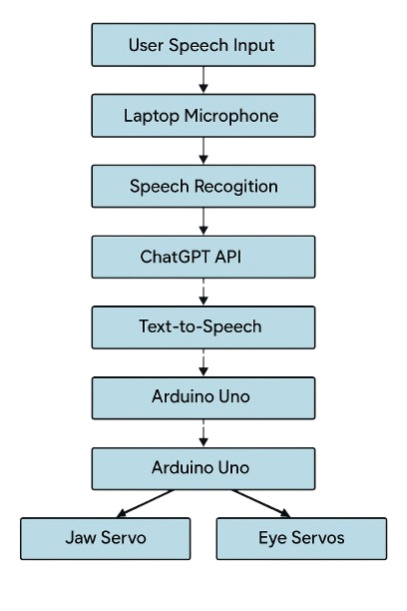
PROPOSED WORK
SYSTEM DESIGN OVERVIEW
Animatronic Robotic Head designed with mechanical actuators and 3D printed plastic to simulate human facial expressions.
Speech Interaction system integrated to enable voice-based conversations.
Control Architecture connects microphone input, speech processing, emotional analysis, expression triggering, and motor control.
Conversation Flow: Listen → Understand → Generate Response → Speak Reply.
Goal: Create an emotionally interactive, human-like robotic companion for elderly users.

Slide 9
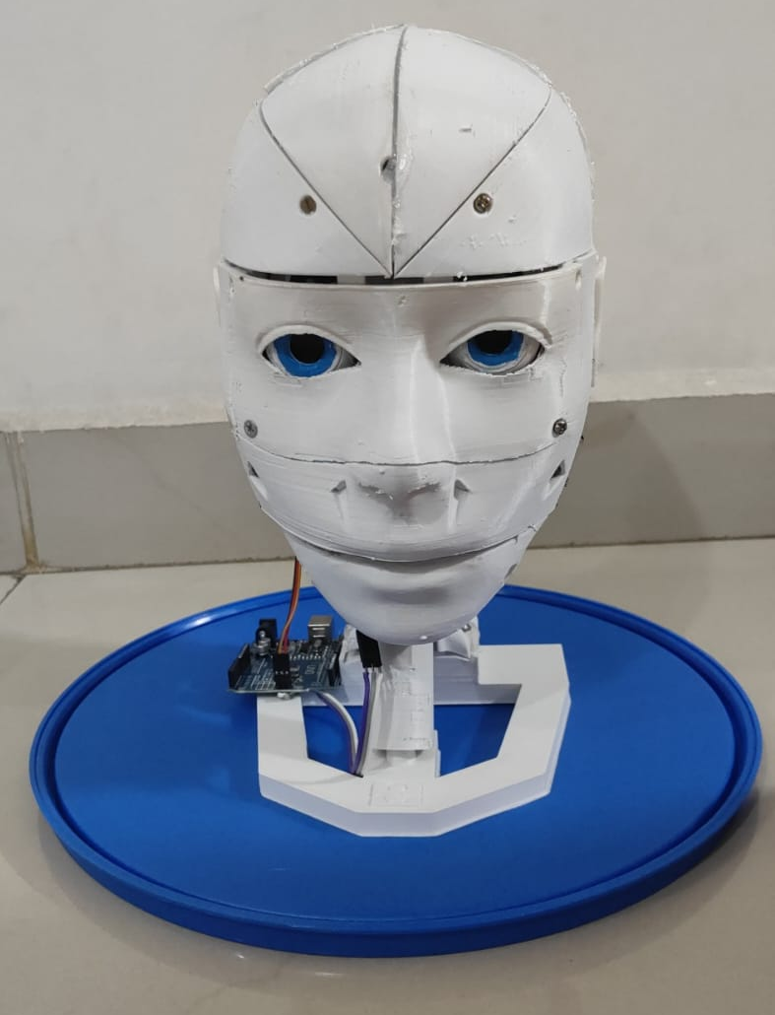
MECHANICAL AND HARDWARE DEVELOPMENT
Servo Motors control specific face parts: Eye movements, jaw movements.
Microphone Array captures clear voice input even in noisy environments.
Speaker Unit placed inside the head for natural sound projection.
Microcontroller manages sensor data processing and motor actuation in
real time.
.

Slide 10
SOFTWARE AND CONTROL SYSTEMS
Voice Recognition Module processes incoming audio into text using offline or online APIs.
Natural Language Processing (NLP) Module understands intent, emotional tone, and generates suitable replies.
Emotion Mapping System links conversational context (happy, sad, surprise, neutral) to corresponding facial expressions.
Servo Motor Controller adjusts facial movements smoothly based on mapped emotional responses.
Synchronization of speech output and facial animation ensures natural human-like timing.

Slide 11
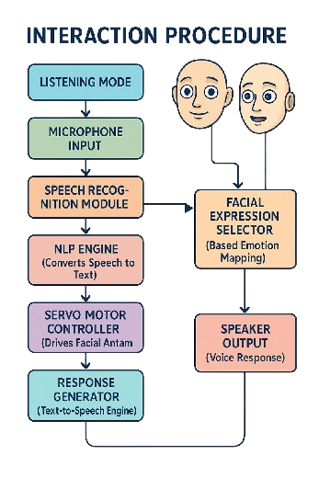
INTERACTION PROCEDURE
Robot remains in listening mode, waiting for user's voice.
When the user speaks, the microphone records the input.
The speech recognition module converts the voice to text.
The NLP engine interprets the text and detects the emotional tone.
Appropriate facial expression is selected from pre-programmed mappings.
Servo motors activate, creating the matching facial animation.
Robot generates and speaks the response using the speaker output.
Process repeats to maintain a continuous, friendly conversation loop.

Slide 12
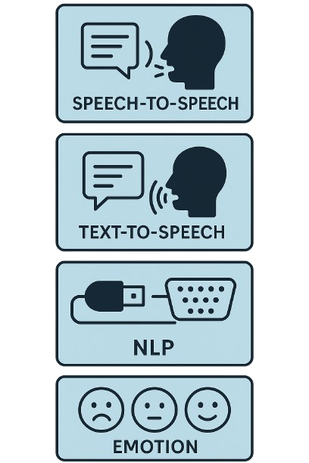
MODULES
SPEECH RECOGNITION MODULE: Captures user speech using high-sensitivity microphones and converts the audio input into text format using advanced speech-to-text algorithms.
NATURAL LANGUAGE PROCESSING (NLP) MODULE: Analyzes the converted text to understand user intent, extract emotional tone, and generate appropriate context-based responses for conversation.
EMOTION DETECTION AND MAPPING MODULE: Detects the emotional context of the user's input and maps it to predefined emotion categories like happiness, sadness, surprise, or neutrality.
MOTOR CONTROL AND SYNCHRONIZATION MODULE: Analyzes the converted text to understand user intent, extract emotional tone, and generate appropriate context-based responses for conversation.

Slide 13
FUTURE ENHANCEMENTS
Emotion detection through voice pitch, speed, and facial expression analysis.
Integration of personalized conversation history to learn user preferences and emotional patterns.
Wireless connectivity with smartphones and health sensors for enhanced caregiving.
Additional facial actuators for complex expressions like eyebrow movement, lip curling, and blinking.
Camera module with facial recognition for visual awareness of surroundings.

Slide 14
RESULTS AND DISCUSSIONS
Hardware integration used an Arduino Uno with MG995 and MG90S servos inside a custom 3D-printed face.
PWM signals and serial commands enabled precise jaw and eye movements.
Servos responded smoothly and in sync with speech, showing no lag or jitter.
Tested with over 100 user comments, confirming natural alignment of speech and motion.
The setup delivered stable, expressive, real-time facial gestures for interactive communication.

Slide 15
CONCLUSION
The animatronic robotic head with facial movements and AI-powered conversations marks a key advancement in human-robot interaction.
Successfully integrates mechanical motion, natural language processing, and embedded control systems to simulate lifelike conversation and behavior.
Servo motors control jaw and eye movements, synchronized with ChatGPT-generated speech output for vocal and non-verbal interaction.
3D-printed materials, Arduino-based actuation, and Python-based AI integration make the system cost-effective, modular, and accessible for educational, experimental, and assistive applications.

Slide 16
REFERENCES
[1] Hanson Robotics (2016) – Sophia
Hanson, D. (2016). Sophia – A Humanoid Robot Integrating Facial Expression and Natural Language Processing. Presented at the AI for Good Global Summit, Geneva, Switzerland. Developed by Hanson Robotics, Hong Kong.
[2] MIT Media Lab (2000) – Kismet
Breazeal, C. (2000). Kismet: Towards Sociable Robots. Proceedings of the IEEE/RSJ International Conference on Intelligent Robots and Systems (IROS), Takamatsu, Japan. MIT Media Lab, USA.
[3] Furhat Robotics (2020) – Furhat Social Robot
Al Moubayed, S., Skantze, G., & Gustafson, J. (2020). Furhat: A Back-Projected Humanoid Head for Multiparty Human-Machine Interaction. Proceedings of the International Conference on Intelligent Virtual Agents (IVA), Glasgow, UK. Furhat Robotics, Sweden.

